Slide 1
Pilot Lab
Usability Study
memreprise
Casey, Brent, Emily, Gray, Tristan

Slide 2
memreprise
where music and memories meet
Notes:
Our team project is memreprise, a mobile app that allows people to capture the musical moments of everyday life.

Slide 3

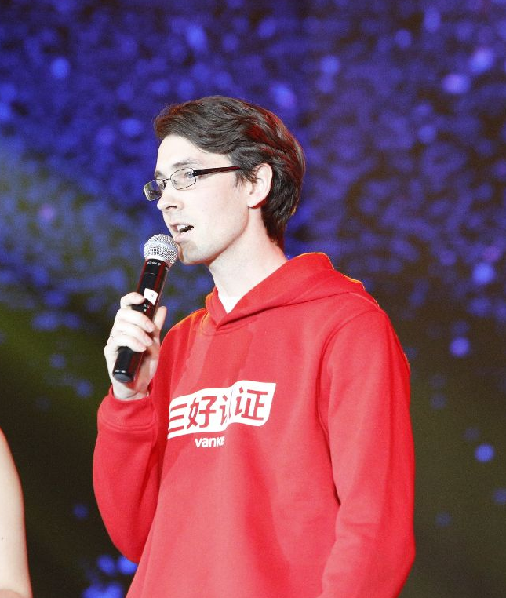
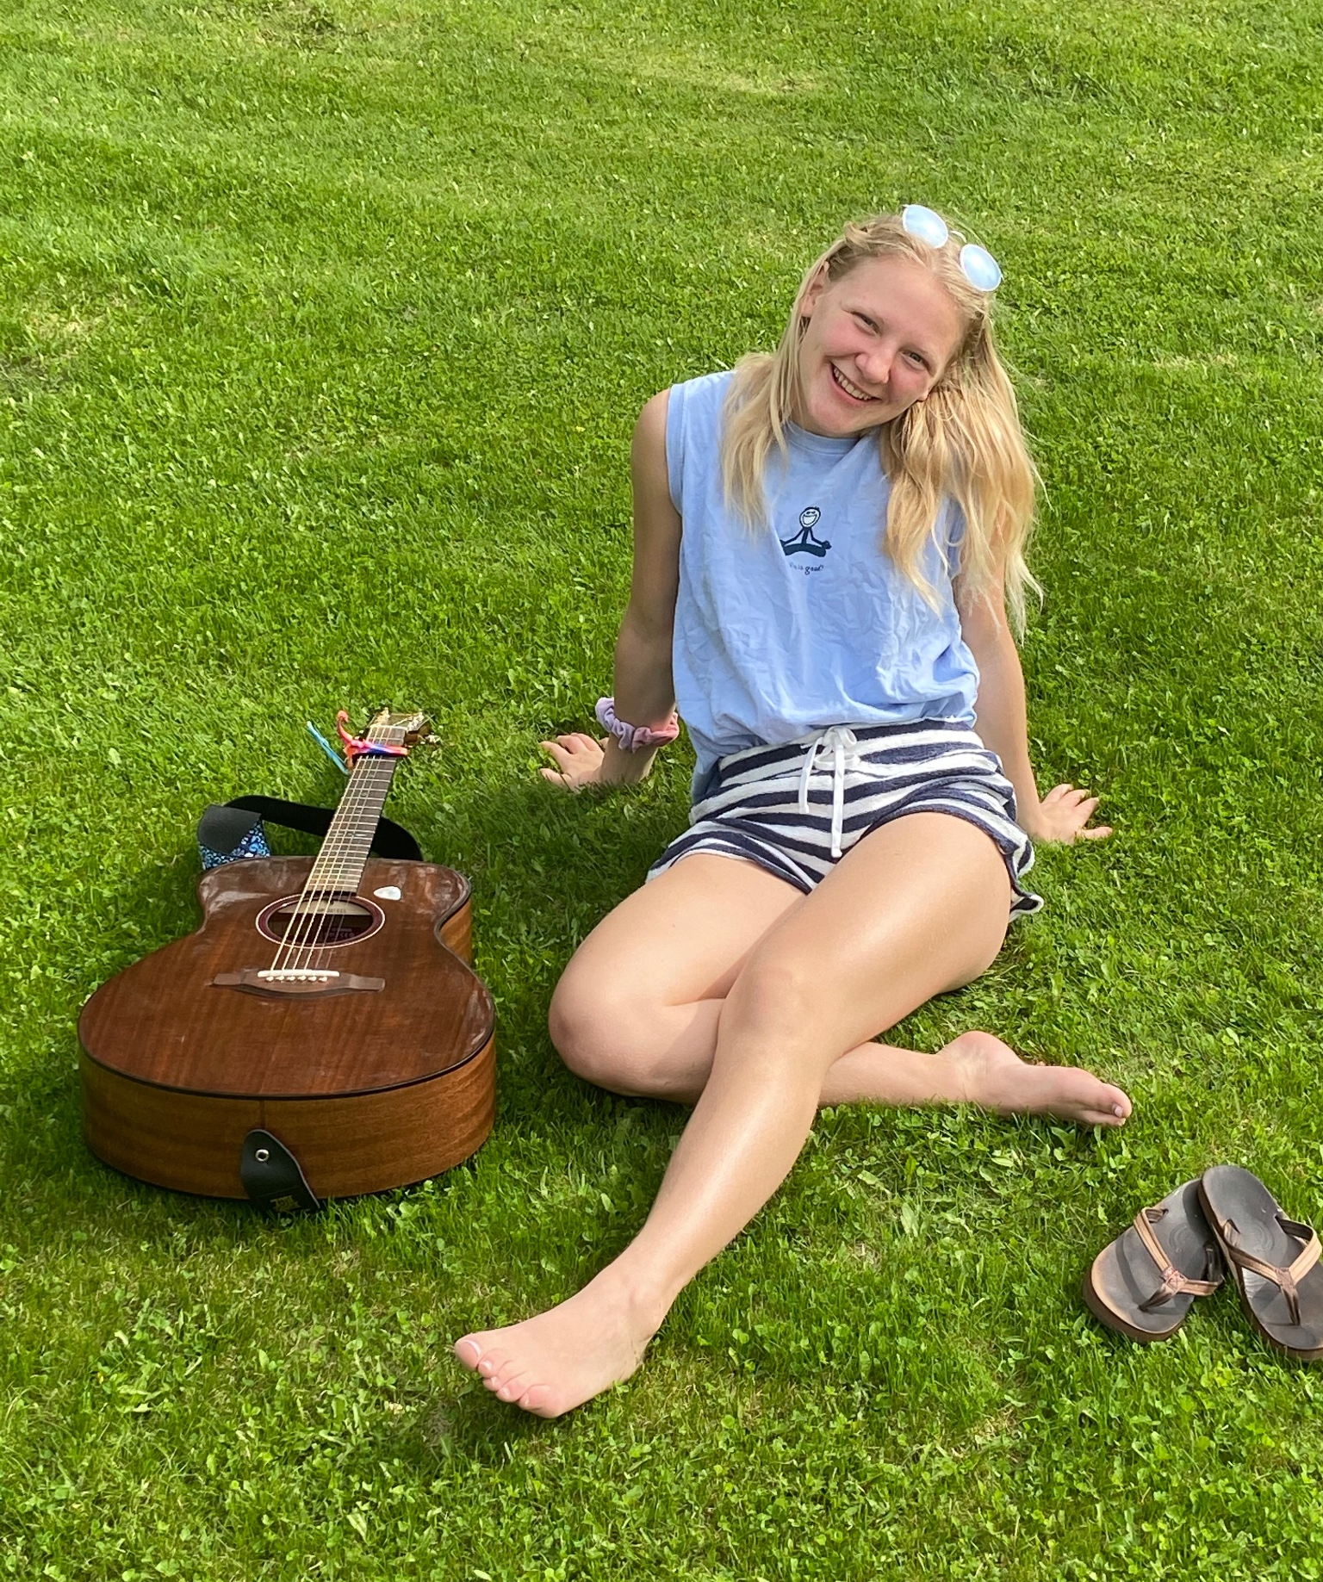
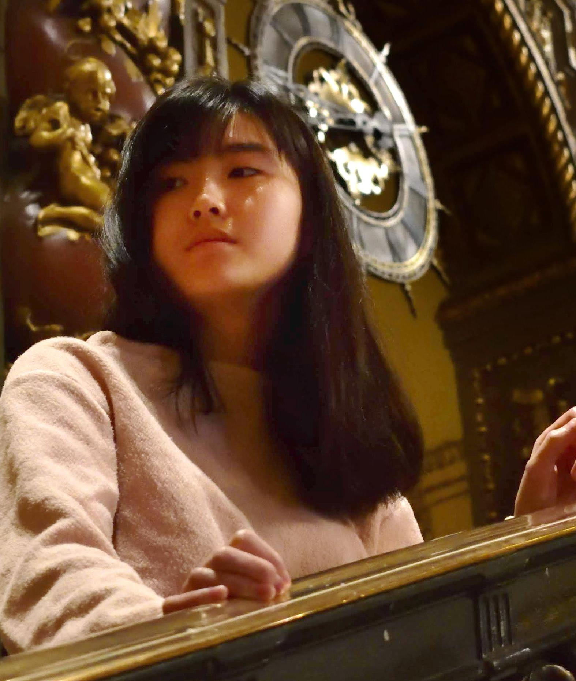
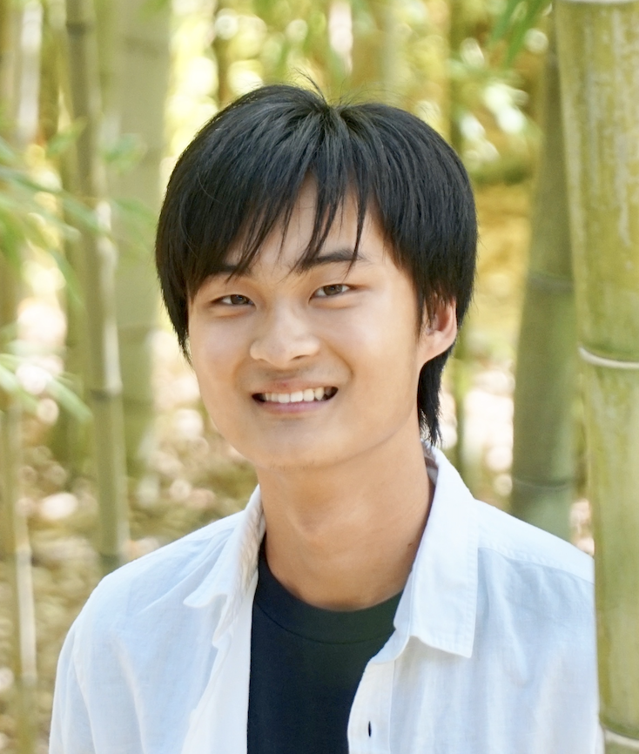
Our Team
Casey
BSCS ‘24, MSCS ‘24
Full Stack Developer
Brent
MSLDT ‘24
Designer, Developer
Author, PM, Educator
Emily
BSCS ‘24, MSCS ‘24
Design, Developer
PM, Writer
Gray
MSCS ‘24
Designer, Developer
Tristan
MSCS ‘24
Designer, Developer
Notes:
We’ve recently had a new addition to our team. Emily has joined our group, making us a team of 5. Our team now consists of Casey, Brent, Emily, Gray, and myself.

Slide 4
Outline
01
02
03
04
Initial Prototype Changes
Method
Results
Discussion
Notes:
In this presentation, we’ll be addressing changes we made to our prototype before we began testing. Then, we’ll talk through our testing method and the results we received. Finally, we will conclude with how our learnings from the pilot study might inform changes in our upcoming experiments, as well as changes we might make to the current interface.

Slide 5
01
Initial Prototype Changes
Notes:
First off, real quick, we didn’t make any changes to the prototype.

Slide 6
No prototype changes were made
in preparation for the test.

Slide 7
02
Method
Notes:
Next up, is the method we used for testing.

Slide 8

Participants
Completed 5 interviews, synthesized 4 of them.
Lucas
Sophomore at UCSC (Game Design & Education)
Bob
Masters Student at Stanford (CCRMA)
Matthew
Senior at Stanford (Civil Engineering)
Wanjun
Stay-at-home mother
Notes:
During our experiment, we completed 5 interviews but only synthesized the results for 4 of them. Our team recruited mostly among close friends and family members. Our participants are: Lucas is a sophomore at UCSC studying game design and education. Bob is a master’s student in CCRMA here at Stanford. Matthew is a senior at Stanford studying civil engineering. Wanjun is a stay-at-home mother.

Slide 9
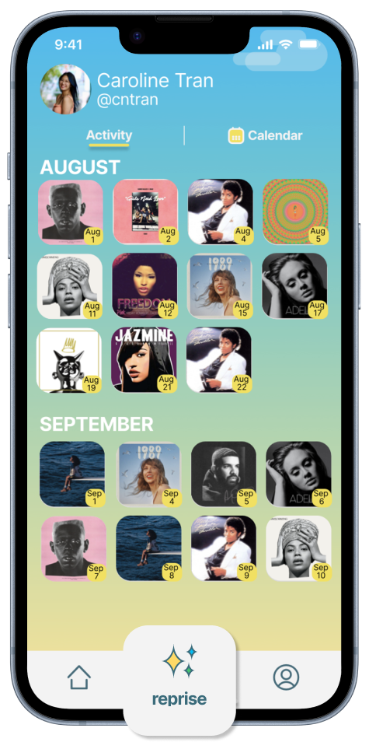


Apparatus
Expo Go
Spotify Account + API
iPhone Screen Recording
Notes:
Our testing was conducted using Expo Go, which allows users to preview our app on their mobile devices. The demo incorporated a Spotify account and API, and the interviews were also recorded using iPhone screen recording for future reference.

Slide 10
Tasks
Task 0: Create an account and go through the tutorial.
Is the sign up process intuitive?
Is the tutorial helpful?
Notes:
The tasks we used to prompt our participants were the same ones we introduced in our project recap presentation. We have a total of 4 tasks, ranging from simplest to most complex.

Slide 11
Tasks
Task 1: Share a song by making a post.
Is the process of sharing a post straightforward for users?
Is Spotify integrated well with the app?
Do users like the current tagging functions (emotion, activity, etc.)? What can be improved?

Slide 12
Tasks
Task 2: Discover music posted by other users.
Is it easy to locate and browse music posted by other users?

Slide 13
Tasks
Task 3: Create a playlist from songs the user recently shared.
Is it easy to locate and browse songs the user shared?
Do users like the current filters (emotion, activity, etc.)? What can be improved?

Slide 14
Procedure
In-person, screen recorded testing.
Users were given prompts for each task. Minimal guidance was given during the tasks.
Users “thought out loud” and testers asked questions as needed.
Testers recorded the duration of each task.
Users were asked debriefing questions at the end.

Slide 15
Test Measures
Task completion
Time to completion
App ratings and reasoning
Critical incidents
Notes:
During our interviews, we measured the 4 following metrics. Whether each task was completed successfully without prompting, how long it took to complete each task, what users would rate the app overall and their reasoning for their rating, as well as any notable incidents that we observed as the participants used the app demo.

Slide 16
03
Results
Notes:
Next up, we compiled the results from our experimentation.

Slide 17
Results
1. Task completion
4/4 2/4 4/4
Share a song Discover music Filter songs
*2 participants did not click “See More” to open playlists in the discover tabs
Notes:
Task completion was good, since almost all users were able to complete the tasks we gave them without prompting, with the exception of one participant who didn’t see the “See More” button for Task 2, which is to discover music posted by other users. We will make this function more prominent in our updated design.

Slide 18
Results
2. Average time to completion of task (min:sec).
2:25 1:11 2:03
Share a song Discover music Filter songs
Notes:
Discover: just swiping through. Filter songs: longer than it should have taken. People couldn’t find where to do this.

Slide 19
Results
3. Overall app satisfaction
3.31/5
Notes:
Not horrible, but definitely lots of room for improvement.

Slide 20
Results
4. Critical Incidents
Lucas
Task 1: Sign-Up and Tutorial
Non-scrollable "Sign Up" screen leading to text blocked by the keyboard.
Concerns about forgetting tutorial instructions due to information overload.
Task 2: Posting a Song
Uncertainty about how to exit the tutorial.
Feedback on the oversized font in the search bar.
Task 3: Discover Feature
Difficulty in navigating back from the "Feeling" tab.
Task 4: Creating a Playlist
Confusion over the purpose of the "Profile" tab.
Unclear meaning and functionality of the "Reprise" feature.
Notes:
Critical incidents. Notable disruptions to the flow of using the app that we need to address as a group going forward.

Slide 21
Results
4. Critical Incidents
Bob
Task 1: Sign-Up
Issue with password autofill during sign-up.
Task 2: Song Selection and Posting
Initial difficulty in scrolling through recent songs from Spotify.
Task 4: Filtering posts
Misalignment with his mental model regarding the placement of the "Reprise" filter.
Unexpected layout and functionality of the "Profile" tab.

Slide 22
Results
4. Critical Incidents
Matthew
Task 1: Tutorial
Attempted to swipe beyond the last tutorial slide, indicating end-of-tutorial was not clear.
Task 2: Song Selection and Posting
Confusion with the keyboard settings when writing caption (looking for emojis).
Task 3: Discover Feature
Did not tap on “see more” text in discover tabs
Task 4: Filtering posts
Repeated attempts to understand and use the "reprise" feature.

Slide 23
Results
4. Critical Incidents
Wanjun
Task 1: Sign-Up & Tutorial
Was unclear about password requirements
Task 2: Song Selection and Posting
Did not understand the purpose of the questions to relate the song to a drink.
The “What are you doing” question did not have a suitable answer to choose, so she chose a random one.
Explored all features - writing a comment, setting visibility, and posting.
Task 3: Discover Feature
Found the discover tab very quickly.
Mentioned she wanted to search within the discover.
Did not see the “See More” button
Task 4: Filtering posts
Did not understand the "reprise" feature.

Slide 24
04
Discussion
Notes:
Finally, we conclude with our learnings from the pilot study, how we might structure upcoming experiments accordingly, and changes we might make to our current interface.

Slide 25
Changes from the pilot

Slide 26

Wider testing population for a longer period of time
Simulate the real use case of MemReprise
Notes:
We do envision MemReprise as an app that users use regularly throughout days or weeks. Ideally, users would be able to use MemReprise for maybe a week to simulate real-world conditions of using it as a music logging and sharing tool

Slide 27
UI Changes

Slide 28
Confusing & Un-engaging Onboarding
Verbose
Hard to recall
Unclear when onboarding ends and how to exit it
Proposed UI Solution:
Add a fun splash page and in place of the log-in screen on user’s first time opening the app.
Move the sign-up experience until after a user has created their first post and is ready to publish it to their profile. Get the user to the joyful part first so they are motivated to complete the logistics!
Have an interactive tutorial where popups inform the user what each function does as they use the app for the first time.

Slide 29
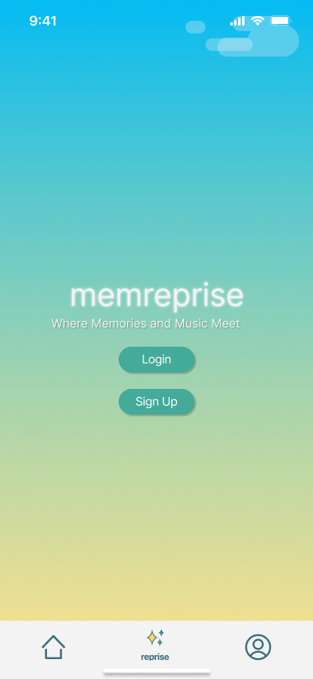
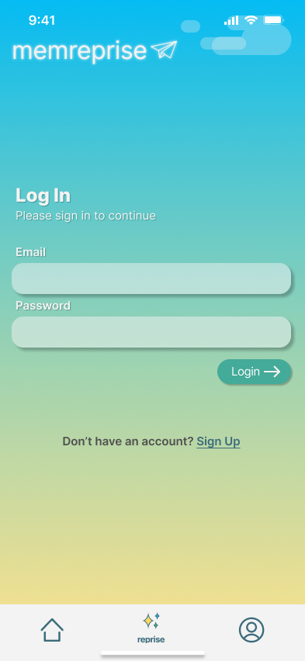
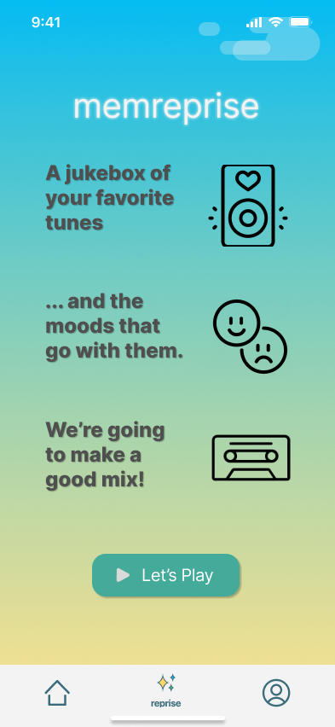
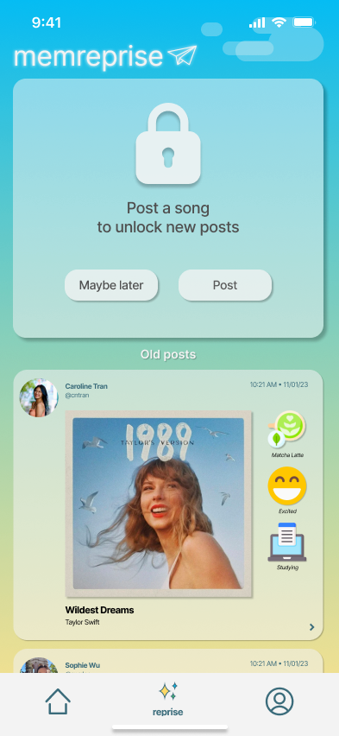
Splash Page to Action Onboarding

Slide 30
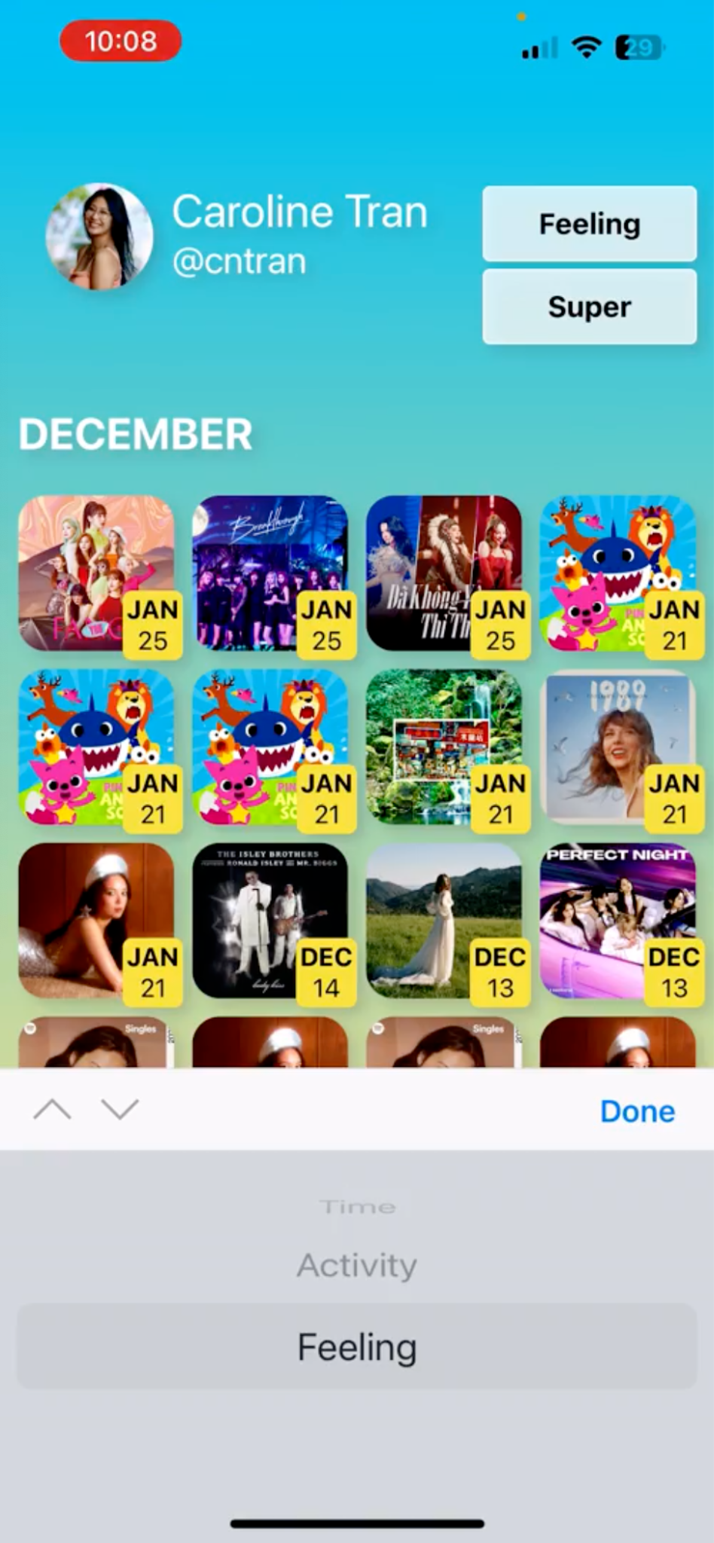
Unaligned mental models
Task 4, Profile section, Reprise function

Slide 31
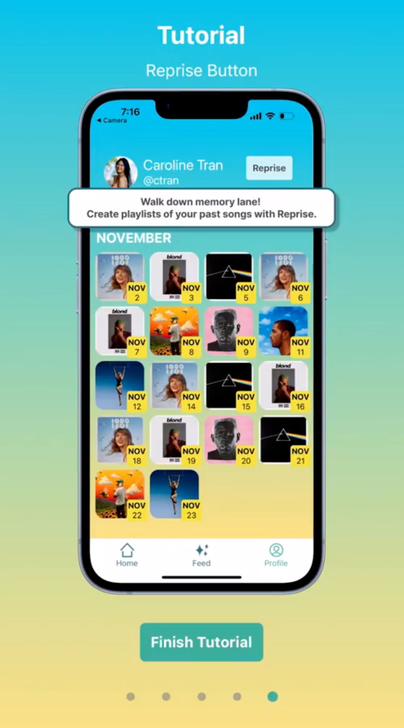
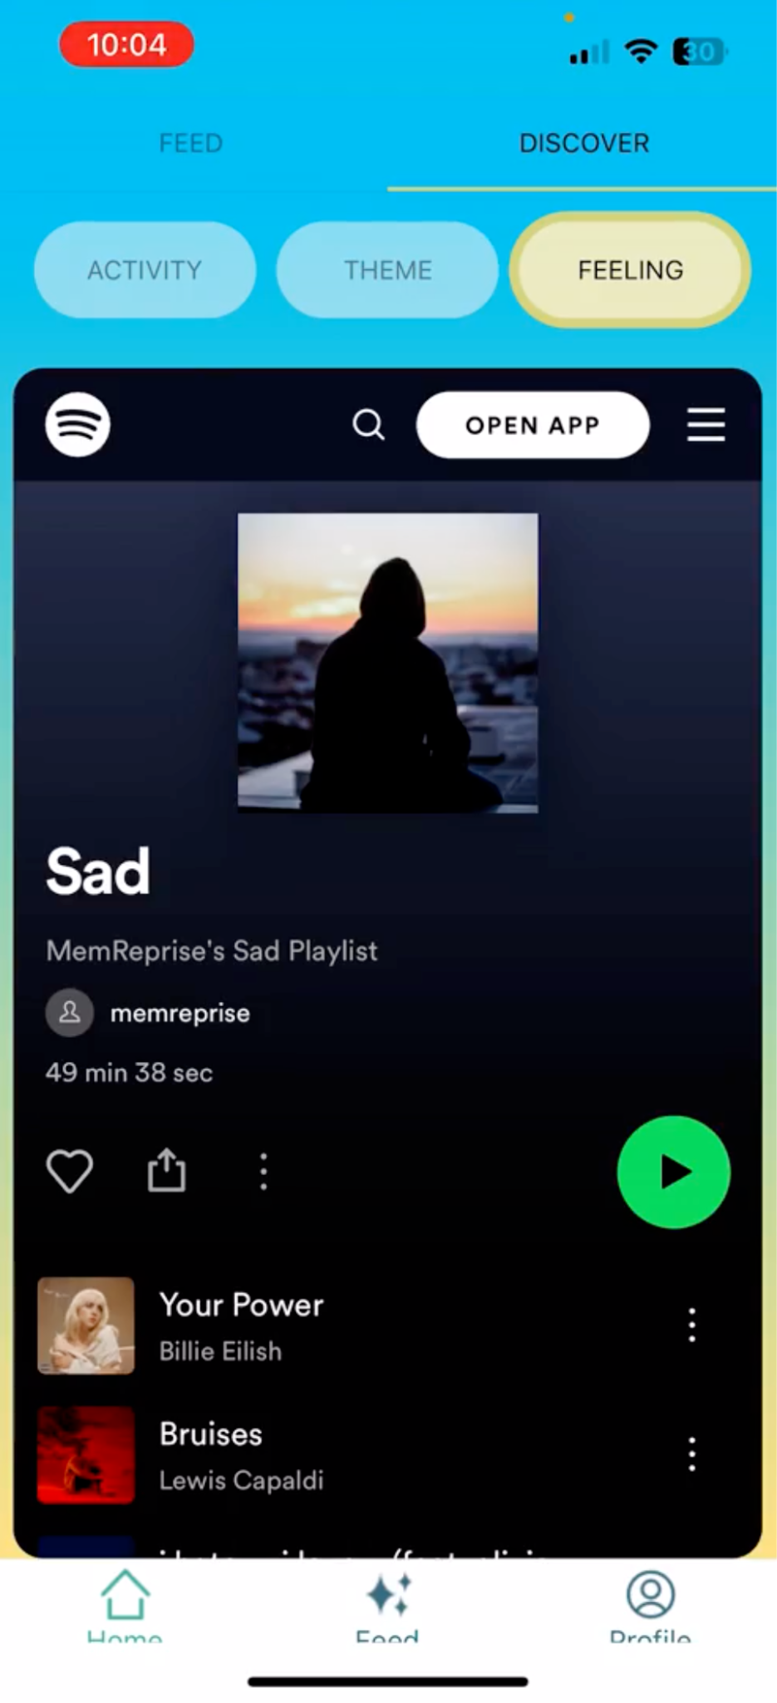
Minor UI adjustments
Consistency
Screen-size issues
Navigation difficulty
See more button text didn’t seem like a button
Navigation bar getting cut off at the bottom
Confusion with finishing tutorial

Slide 32
Positives
Spotify integration was seamless and easy to navigate

Slide 33
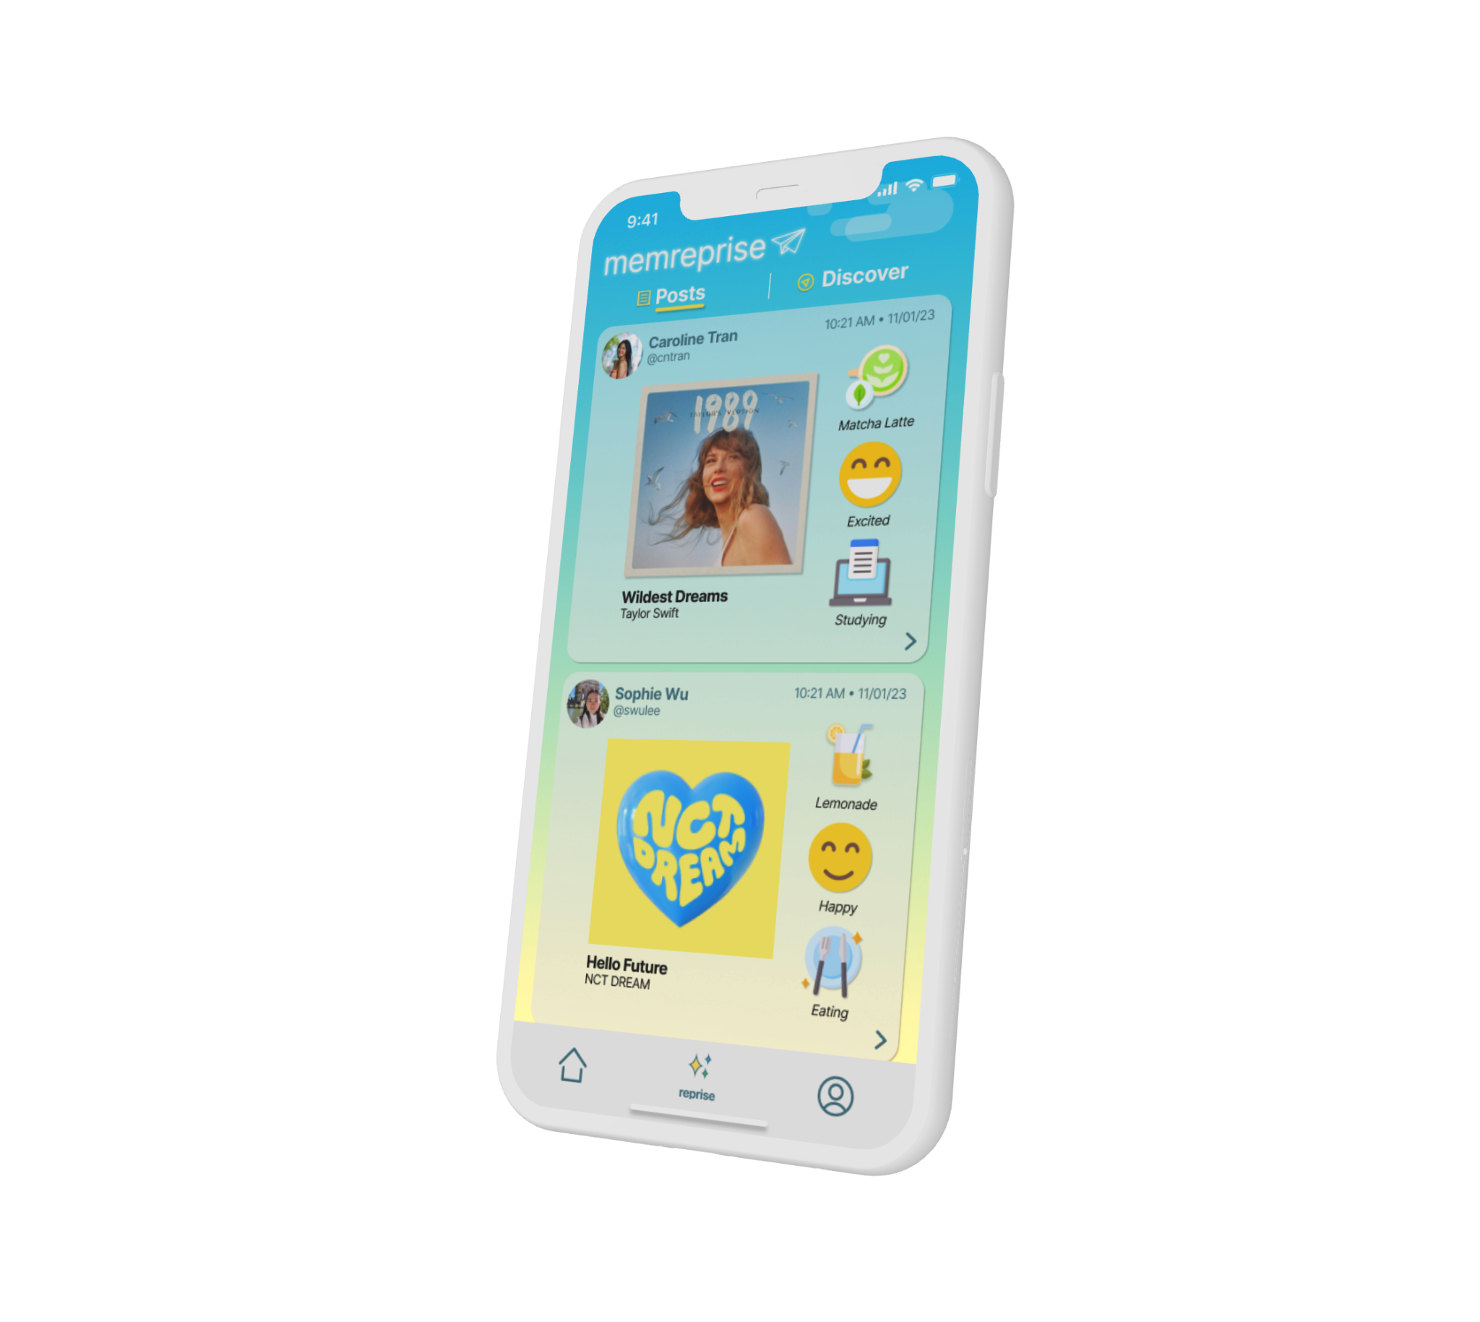
Thanks
Do you have any questions?

Slide 34
COLOR SCHEME FOR SLIDES
#ffd966
#fce08c
#fff3ce
#1c2e50
#9ecaec
#44aa99
#a2cec6

